Slide 1
Scoliosis visualization using ultrasound data
Ben Church

Slide 2
Contents
Background
Landmark-based visualization
Automatic landmark generation
Full workflow
Discussion and conclusions

Slide 3
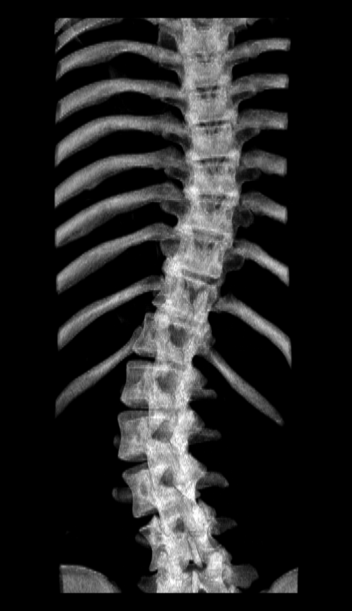
Background - Scoliosis
Pathologic spinal curvature in 3D
Usually diagnosed in adolescence
Curvature progresses with growth

Slide 4
Background - Assessment
Progression requires monitoring
Cobb angle is the standard measure of scoliotic severity
Cobb angle is measured with X-ray

Slide 5
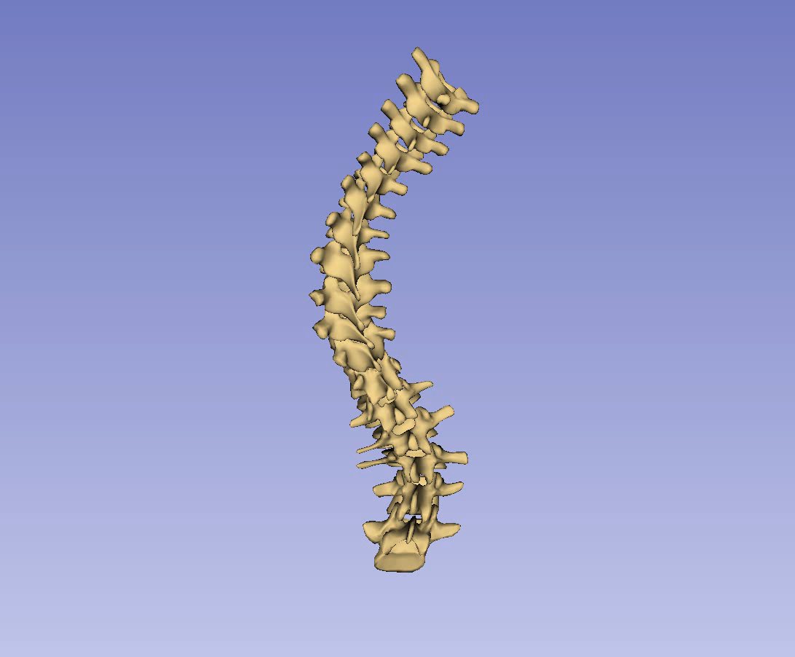
Background – Assessment
Patient-specific treatment requires 3D assessment
CT or MRI may be used for treatment decisions
Cannot be used for regular assessment

Slide 6
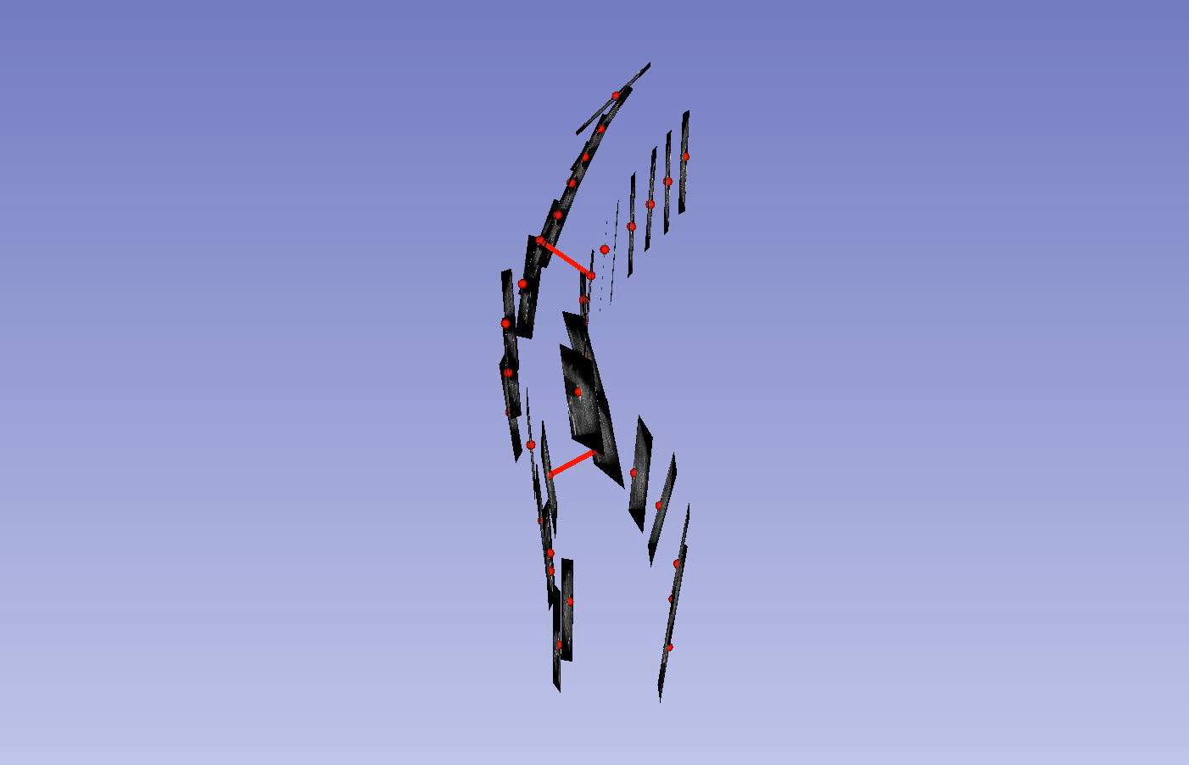
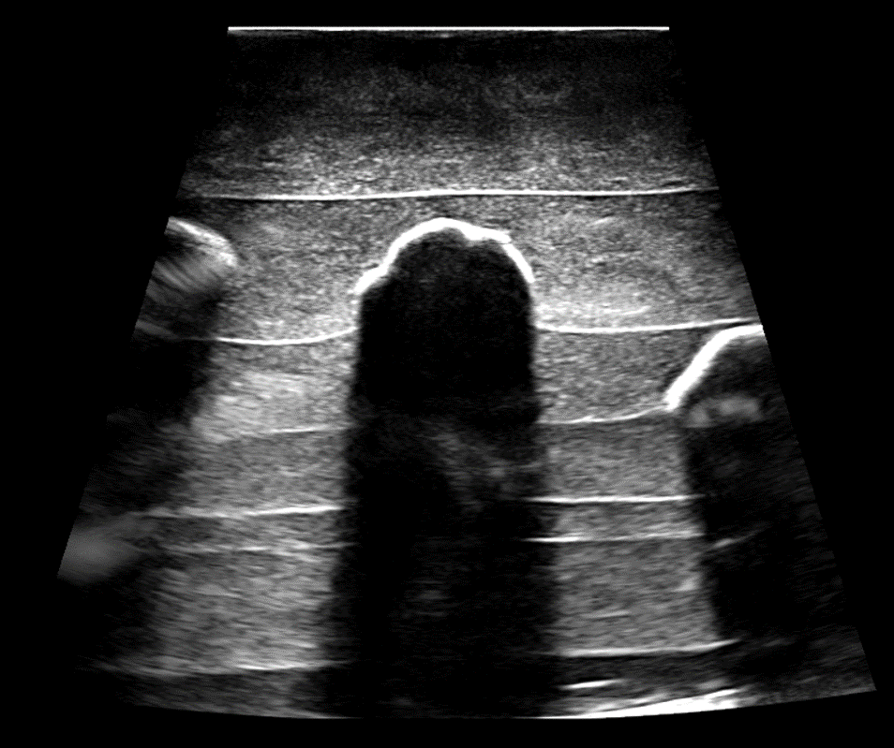
Background - Ultrasound
Radiation-free, inexpensive, and accessible
Can measure curvature using skeletal landmarks

Slide 7
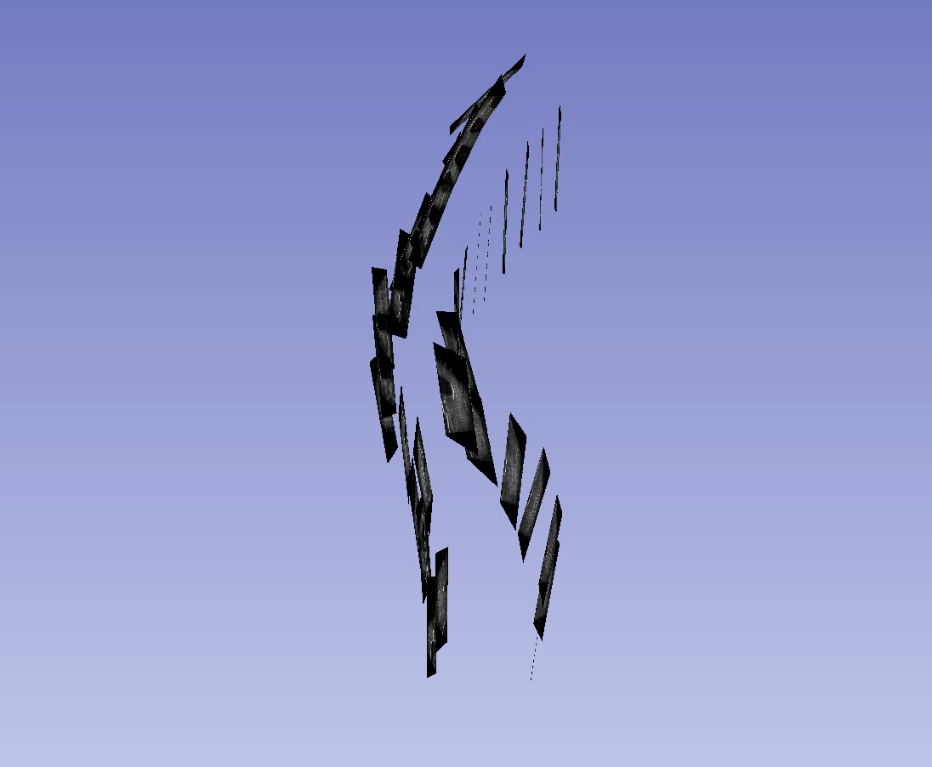
Background - Ultrasound
Scoliosis assessment can benefit from 3D patient-specific spinal visualizations generated from ultrasound data

Slide 8
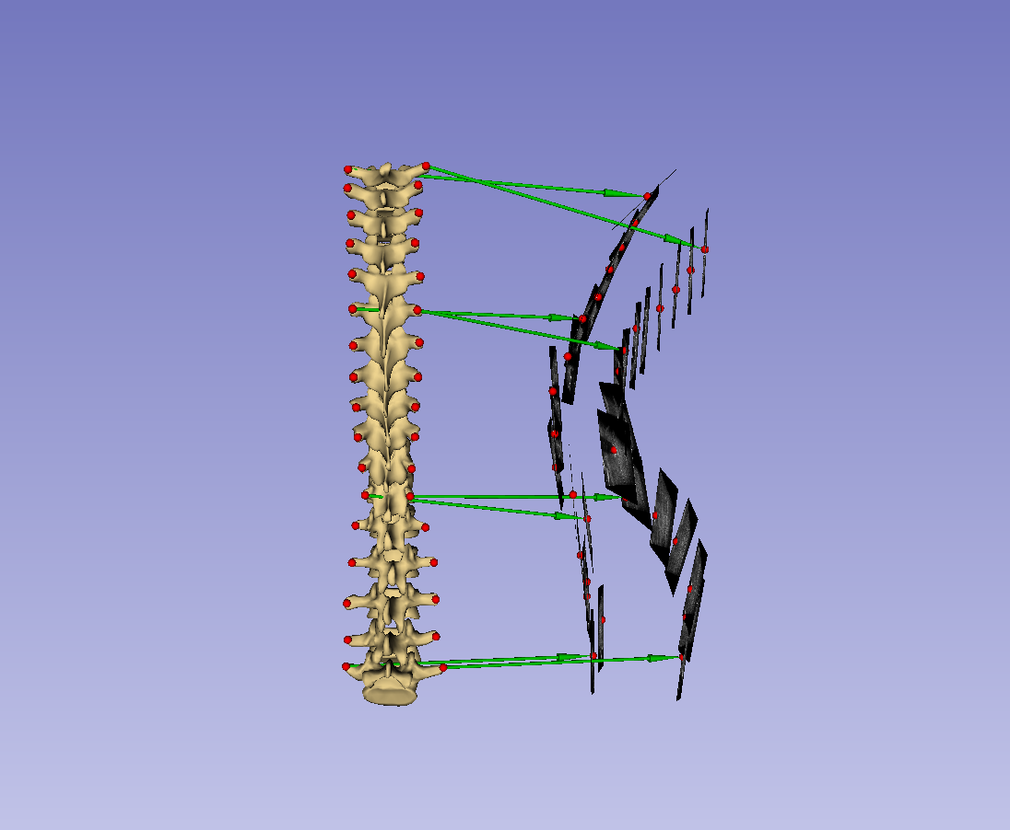
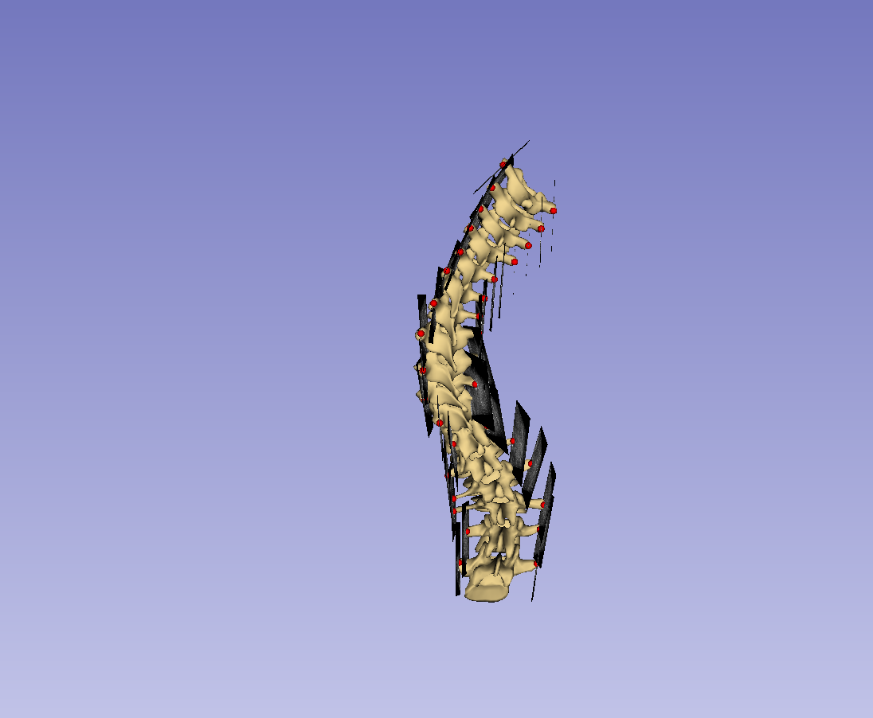
Visualization
3D spinal visualizations can be produced by warping a healthy-shaped model to patient skeletal landmarks

Slide 9
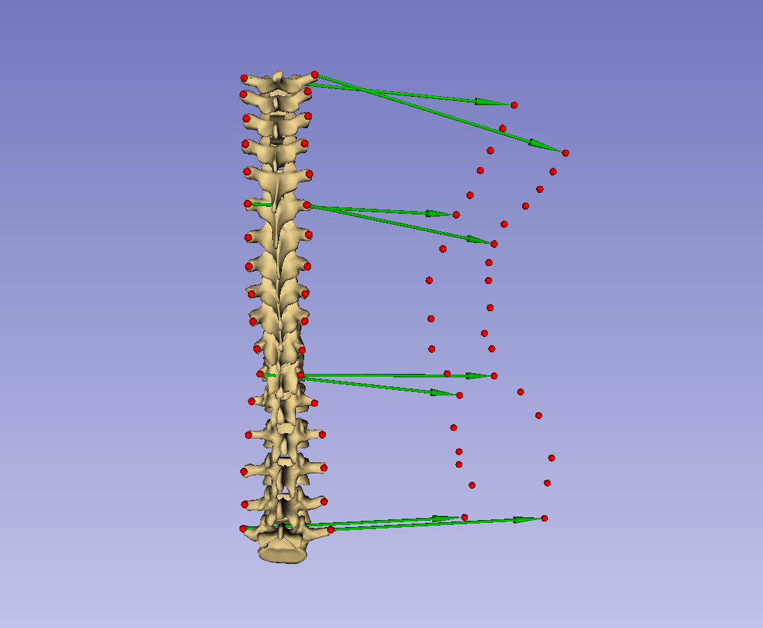
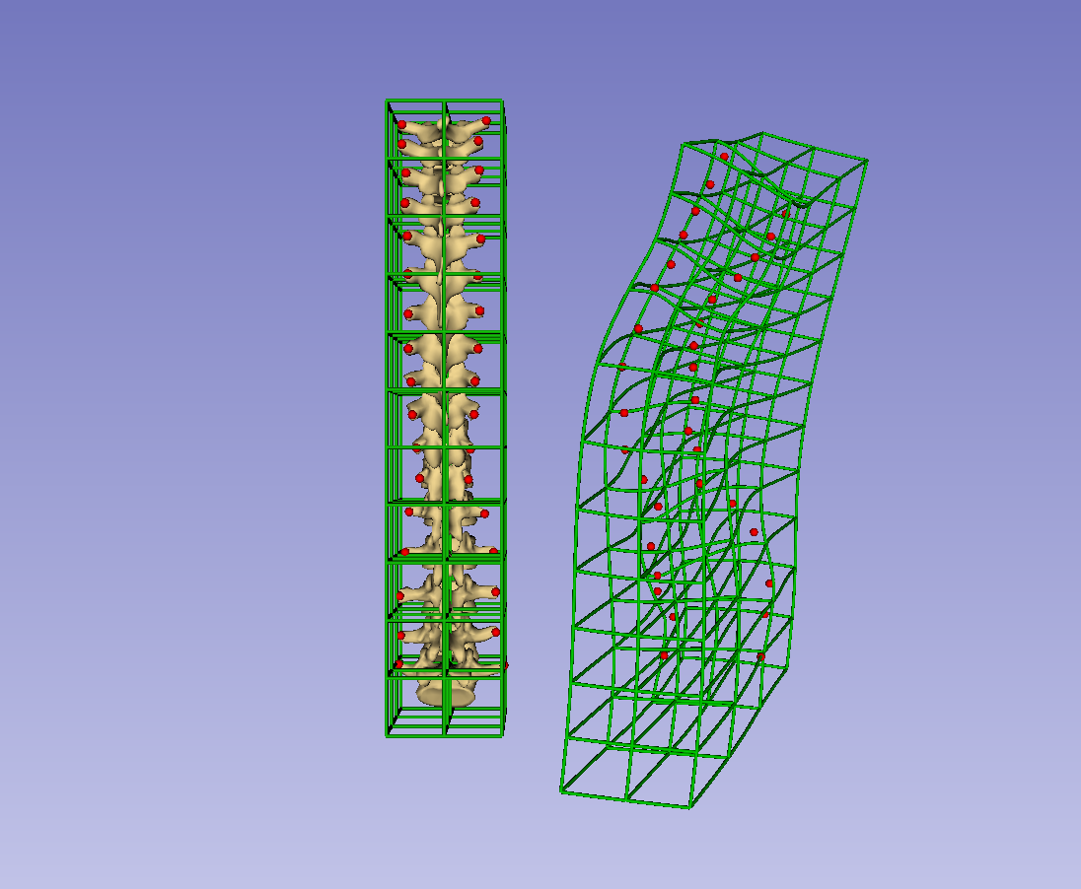
Visualization – Registration
Thin-plate spline registration produces deformed spaces by interpolating transforms between source and target landmarks

Slide 10
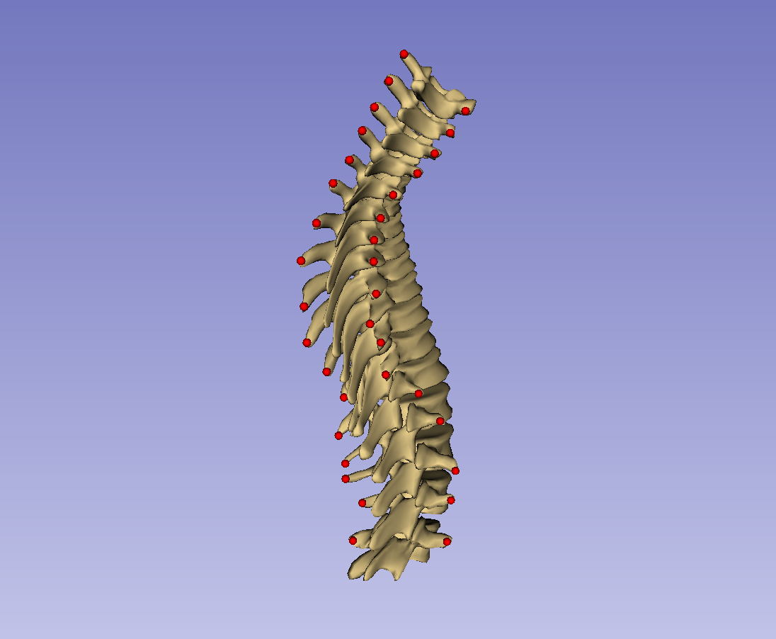
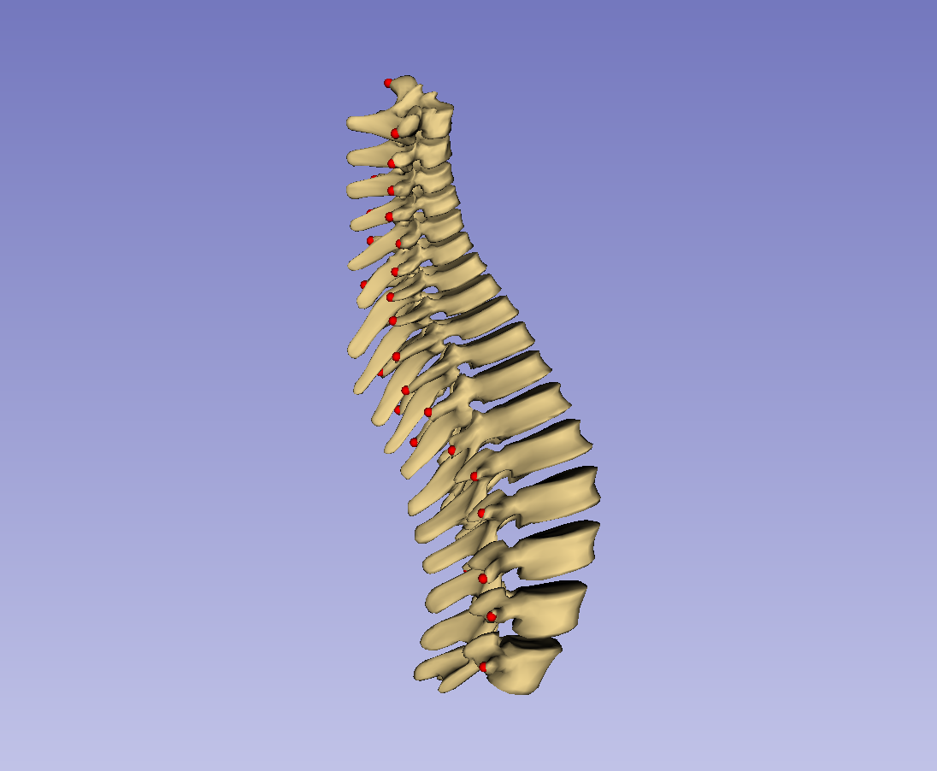
Visualization – Registration
Thin-plate spline requires landmarks to constrain deformation
Transverse processes alone lack anterior-posterior distribution

Slide 11
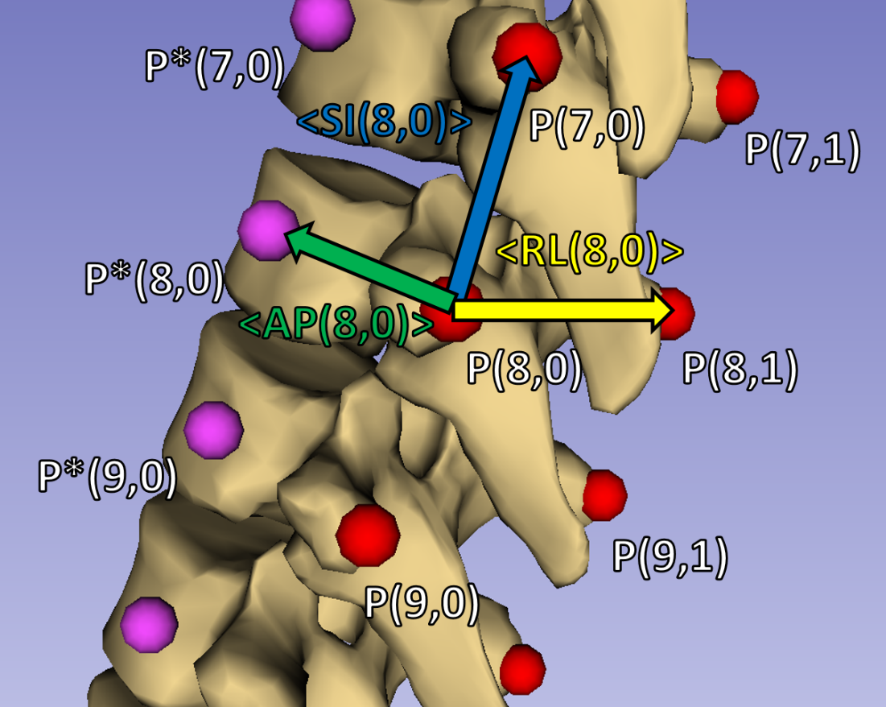
Visualization – Registration
Direction of vertebral bodies is computed from transverse process locations
Anchor point is added to each natural landmark to constrain spline

Slide 12
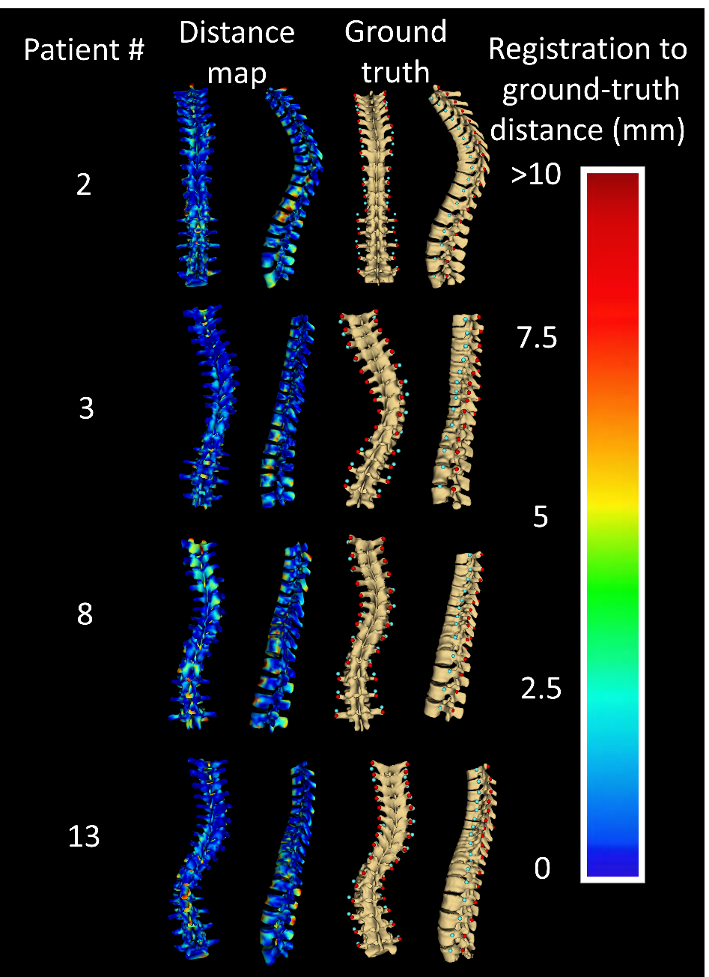
Visualization – Results
Distance maps give overall impression of visualization accuracy.

Slide 13
Landmark generation
Manual landmark identification is the most time-consuming step of proposed visualization method
Automatically generating landmark from ultrasound could substantially reduce operator interaction

Slide 14
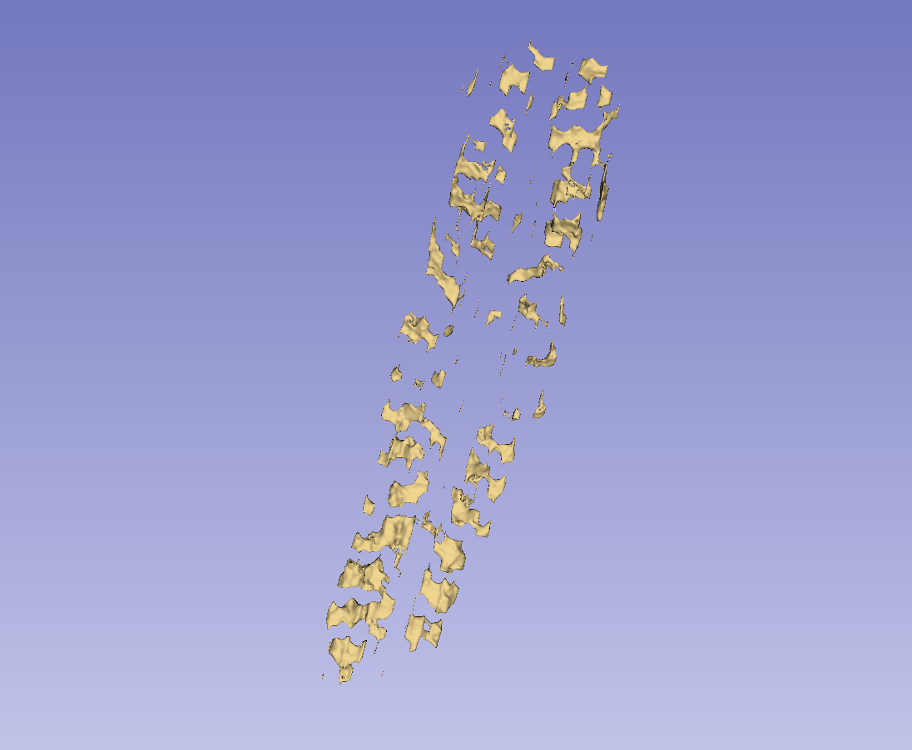
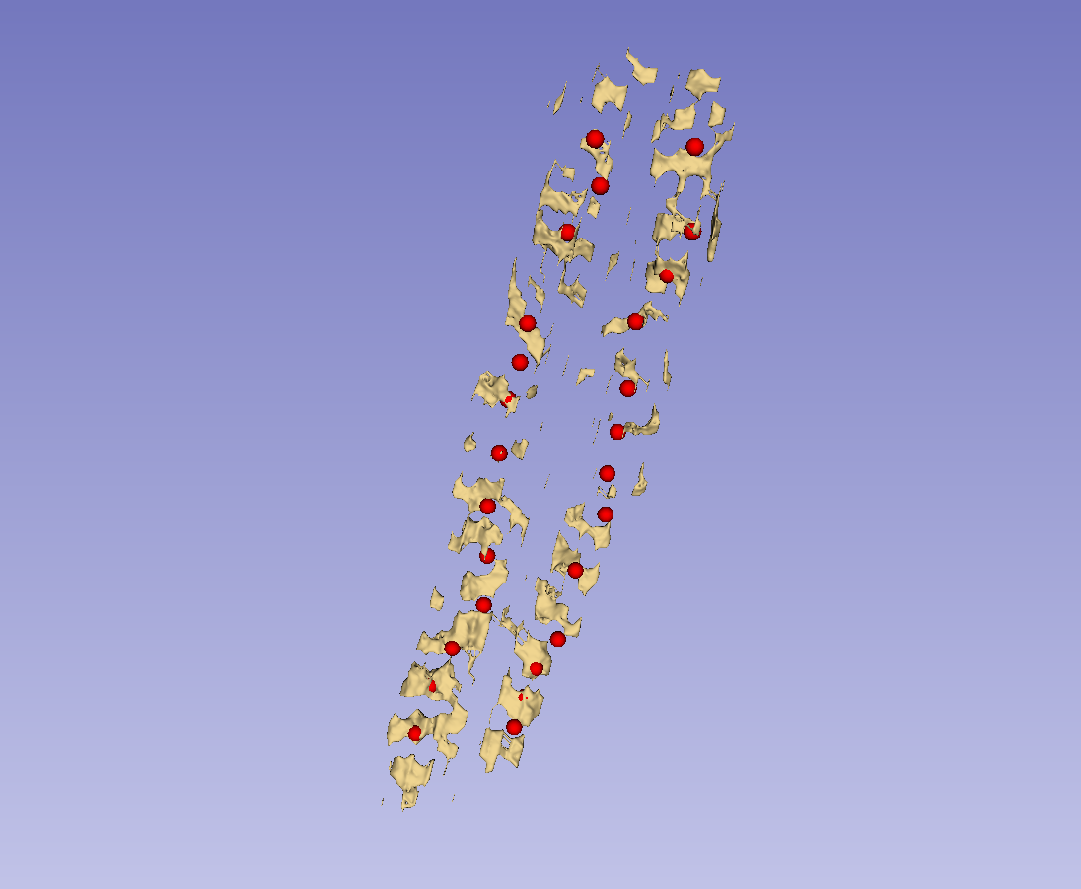
Landmark generation – k-means
Bone segmentations can be reduced to landmark sets with k-means algorithm.

Slide 15
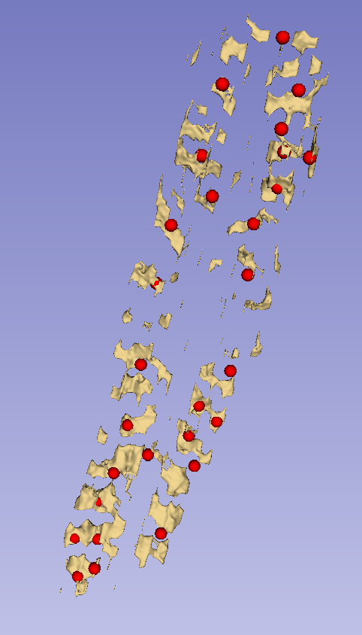
Landmark generation – Defects
Landmarks from k-means may have several defects:
Multiple points on a single landmark
Missing points on landmarks
Incorrectly placed points

Slide 16
Landmark generation – Defects

Slide 17
Full workflow
Automatic landmark generation
Tracked ultrasound scan
Bone segmentation
Landmark generation
Landmark set repair
Scoliosis visualization
Healthy-shaped surface and landmarks
Thin-plate spline registration
Transverse process locations
Patient-specific 3D surface visualization

Slide 18
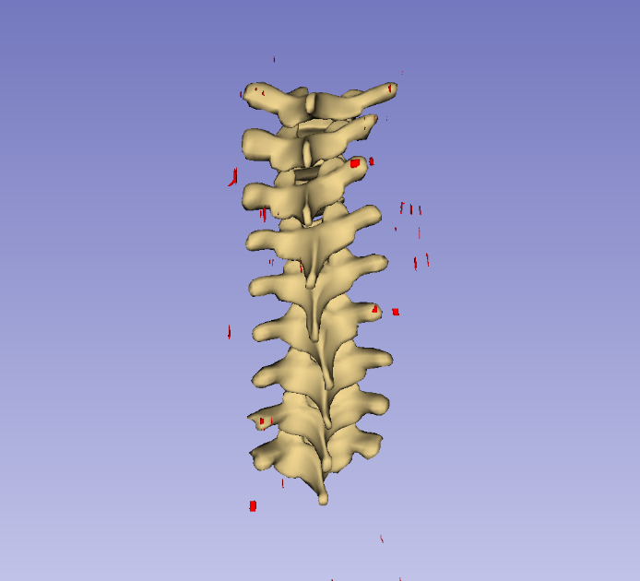
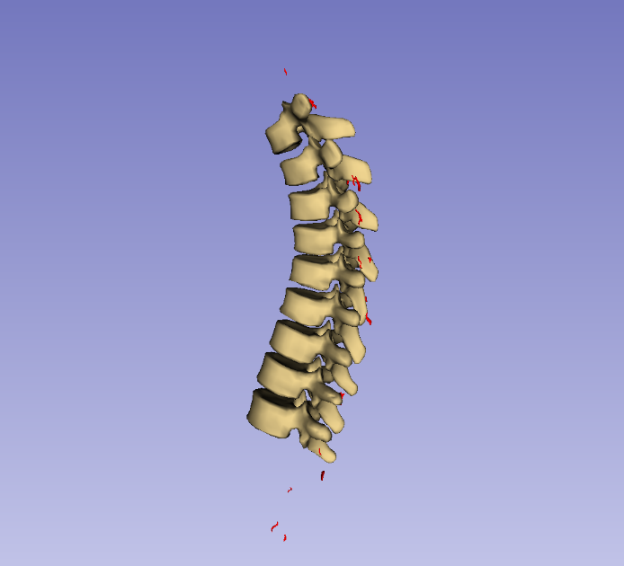
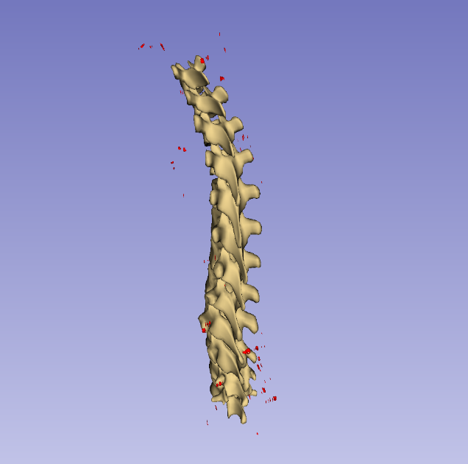
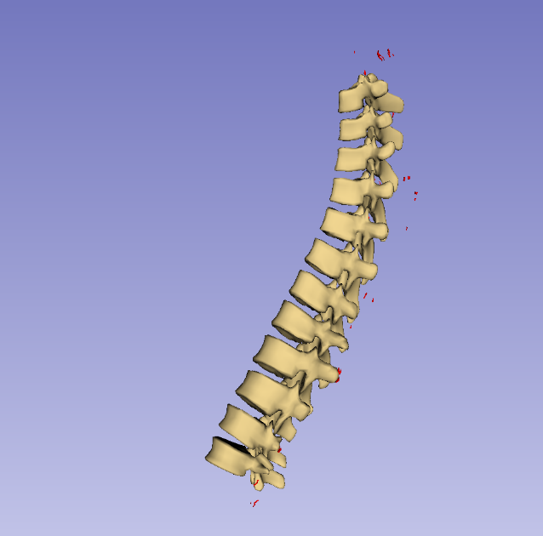
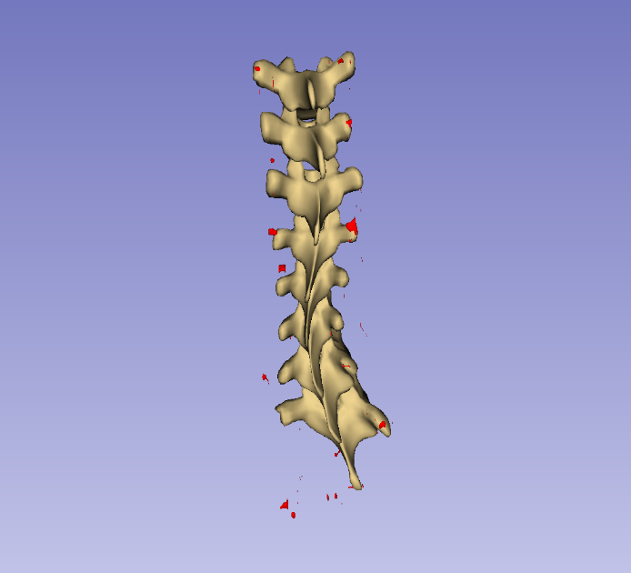
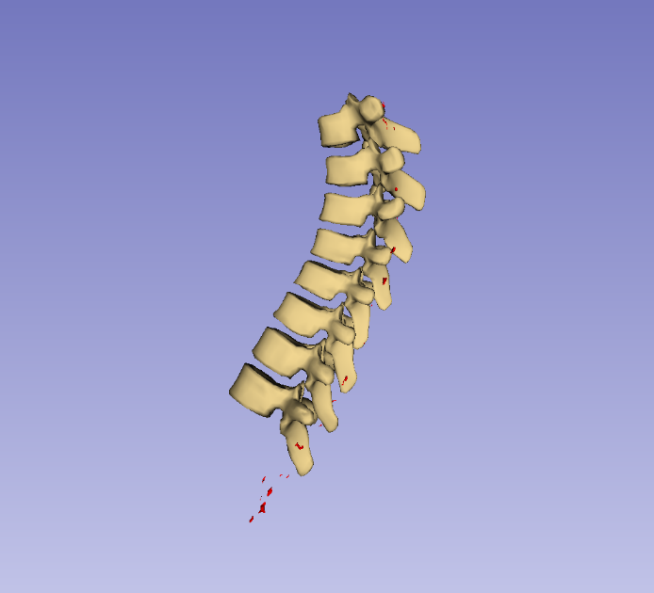
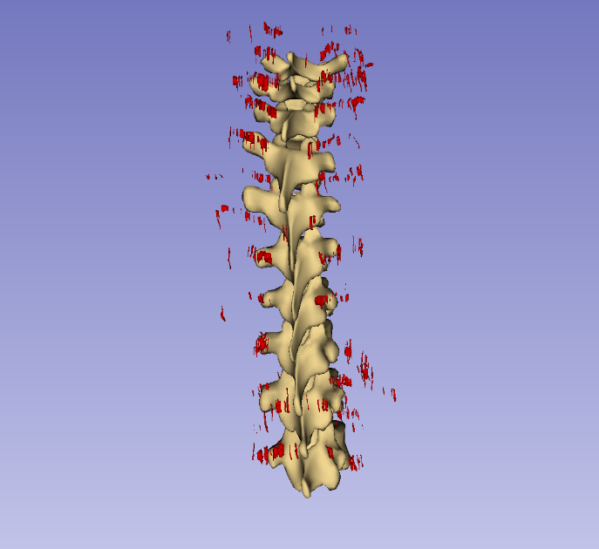
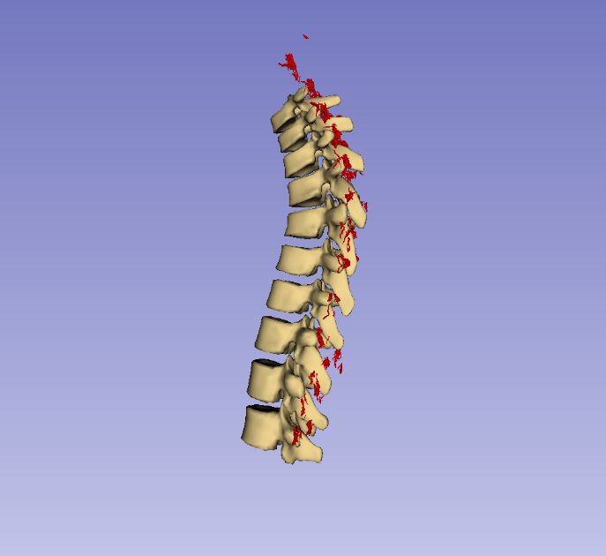
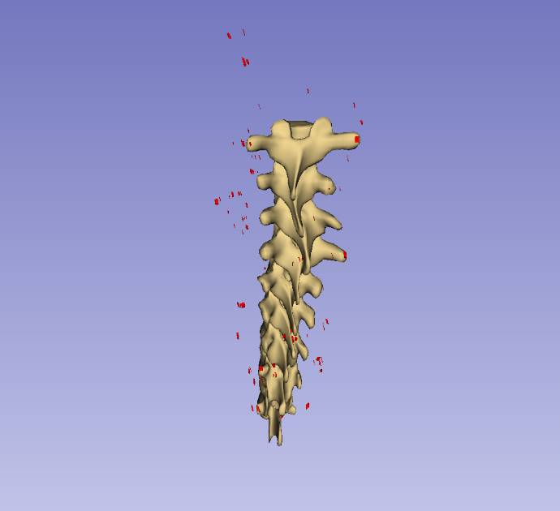
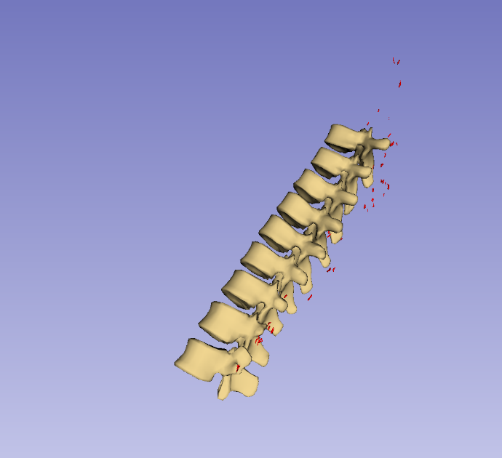
Full workflow

Slide 19
Discussion and conclusions
Combination of presented methods bridges gap between ultrasound and 3D visualization
More validation required, depending on application
Method may see modular improvements

Slide 20
Thank you!
Questions?

Slide 21
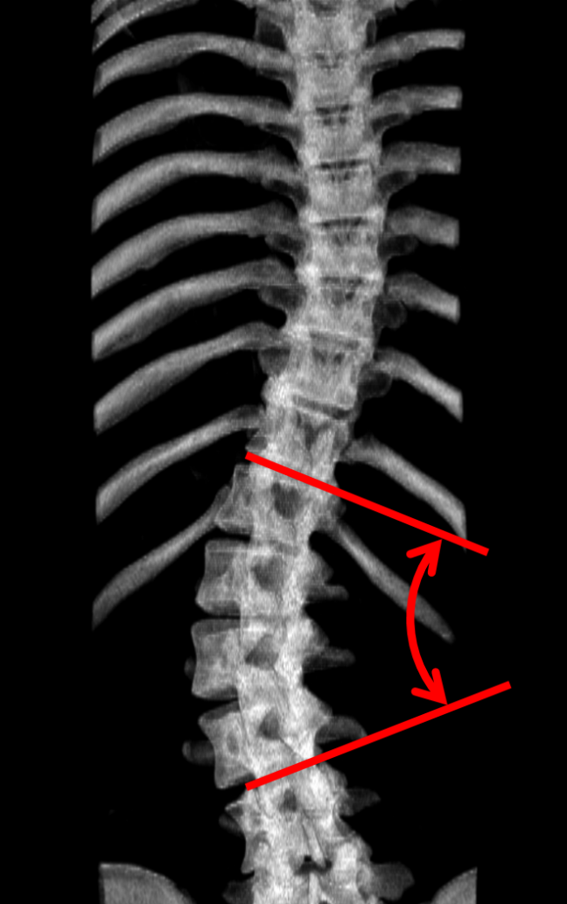
Background – X-ray
X-ray uses ionizing radiation
X-ray assessment is limited to planar views

Slide 22
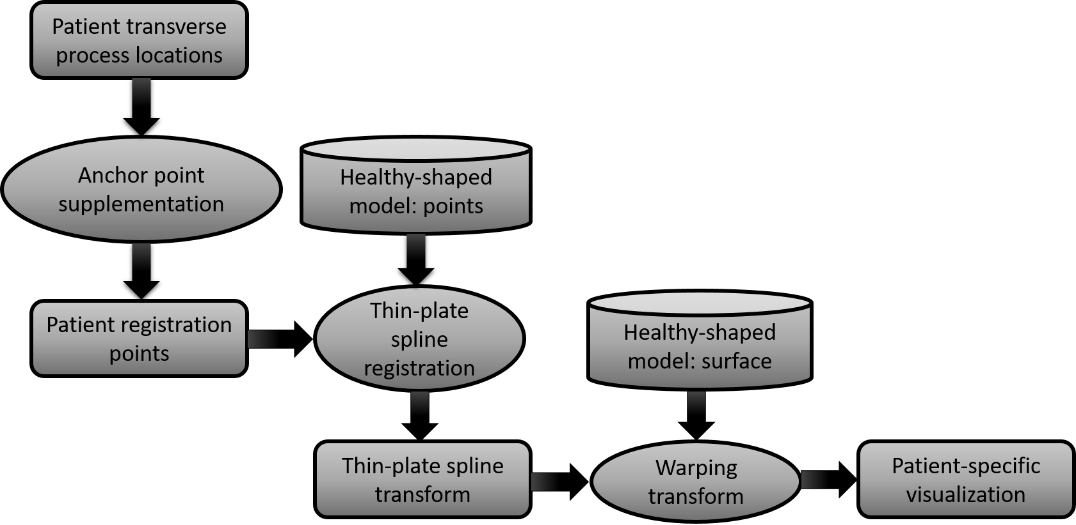
Visualization - Overview

Slide 23
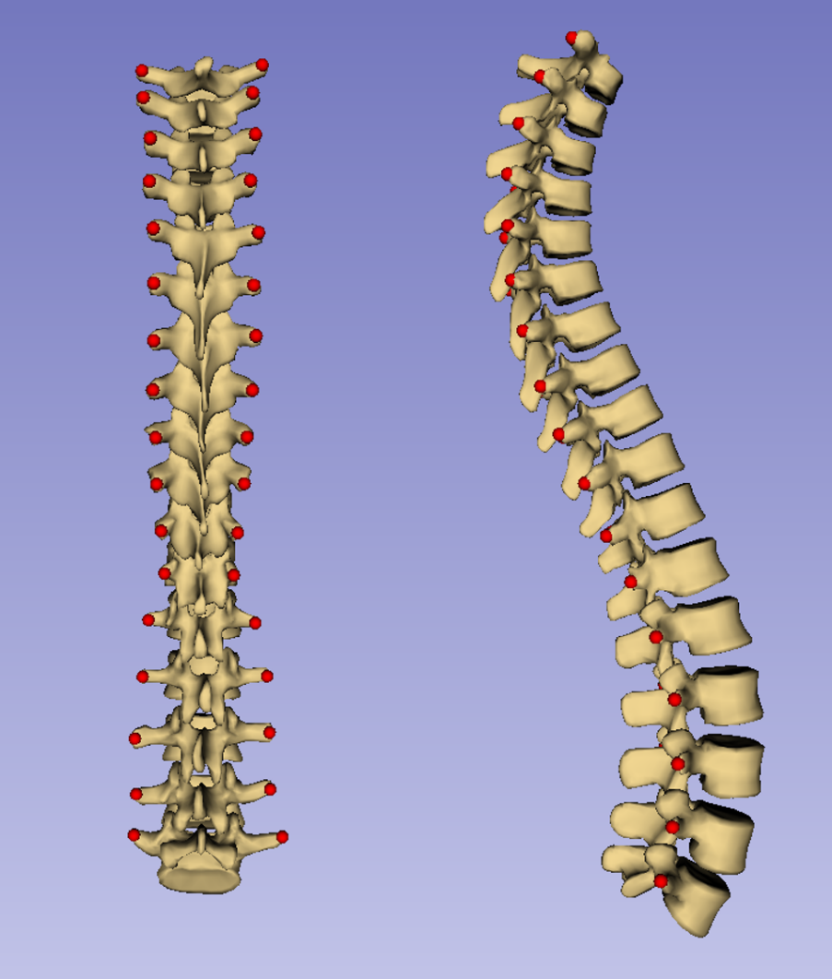
Visualization – Healthy model
Healthy-shaped model consists of landmarks corresponding to patients’ and a surface to be warped

Slide 24
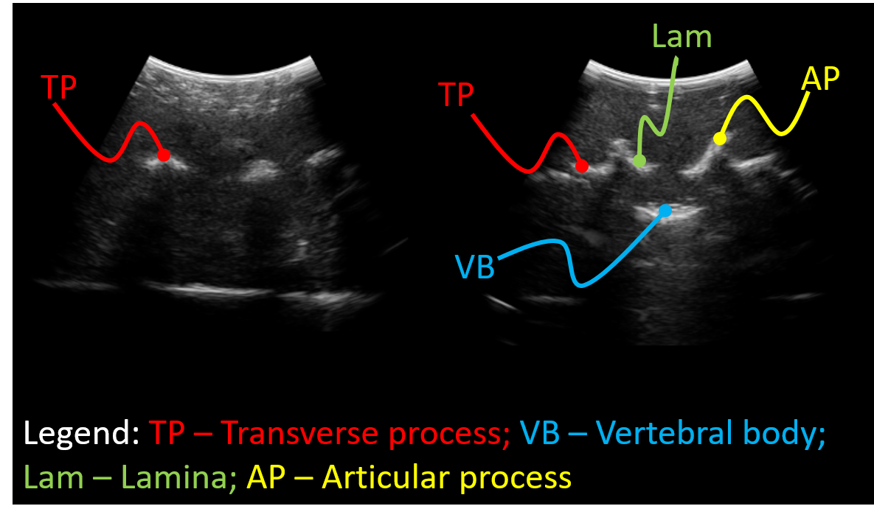
Visualization - Landmarks
Transverse processes were chosen as landmarks for suitability with ultrasound

Slide 25
Visualization – Results
Visualizations were generated from 16 scoliotic patients’ transverse process locations
Accuracy of visualizations was assessed by comparing to CT ground-truth

Slide 26
Visualization – Results
Hausdorff distances and Dice coefficient describe accuracy quantitatively.
Patient # | Maximum Hausdorff (mm) | Average Hausdorff (mm) | Dice coefficient
1 | 16.3 | 2.2 | 0.63
2 | 19.7 | 2.5 | 0.63
3 | 20.0 | 2.0 | 0.63
4 | 13.1 | 2.3 | 0.59
5 | 16.3 | 2.5 | 0.58
6 | 17.9 | 2.5 | 0.57
7 | 16.0 | 2.4 | 0.59
8 | 15.1 | 2.9 | 0.53
9 | 11.4 | 2.0 | 0.69
10 | 9.4 | 1.7 | 0.69
11 | 17.1 | 2.4 | 0.57
12 | 14.0 | 2.4 | 0.64
13 | 14.8 | 2.7 | 0.53
14 | 14.6 | 2.5 | 0.61
15 | 13.3 | 2.0 | 0.63
16 | 15.3 | 1.8 | 0.58
Average | 15.3 | 2.3 | 0.61
Standard deviation | 2.7 | 0.3 | 0.04

Slide 27
Visualization – Discussion
Visualizations capture 3D deformation
Inaccuracies mainly at boundaries and vertebral bodies

Slide 28
Visualization – Discussion
Method has not been validated for navigation
Method has been used in work by Baum et al.

Slide 29
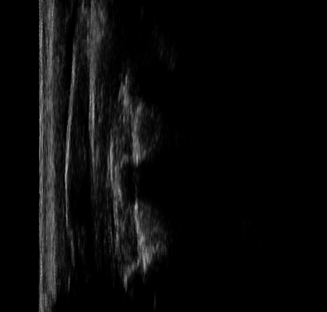

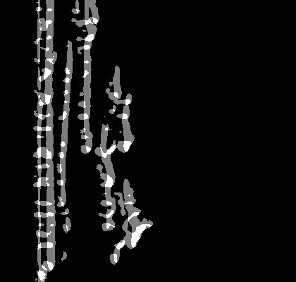
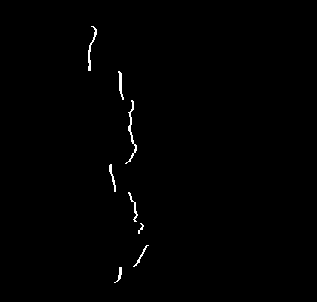
Landmark generation - Segmentation
A new PLUS tool was used to segment bones from spinal ultrasound

Slide 30


Landmark generation - Segmentation
The method checks for acoustic shadows to determine presence of bone

Slide 31
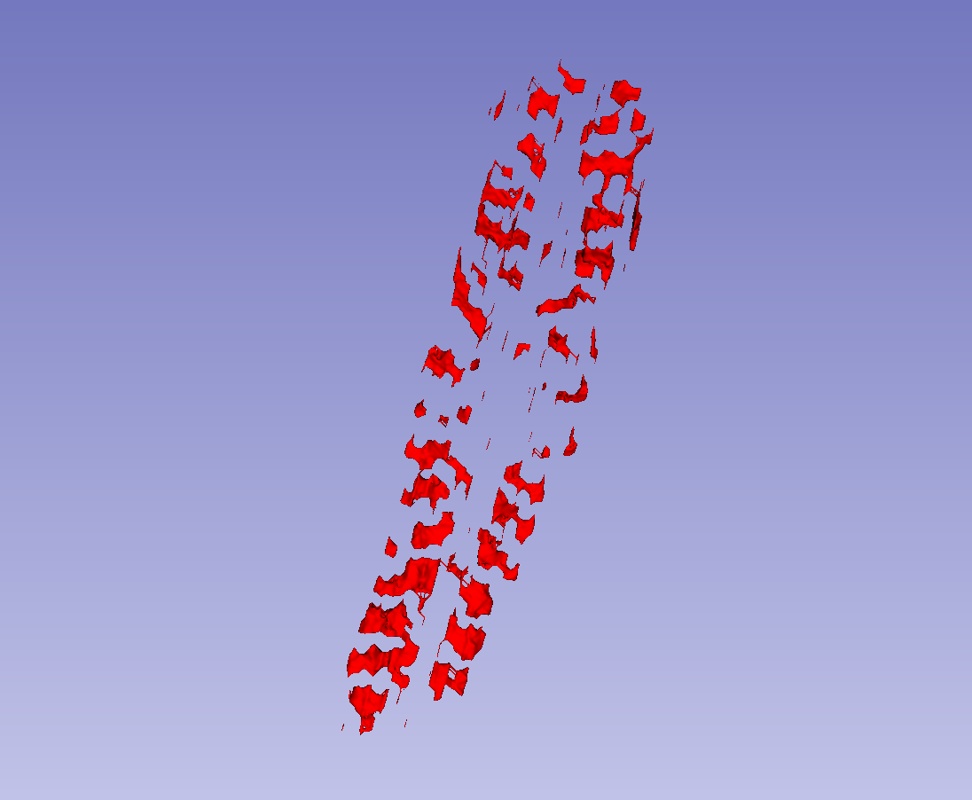
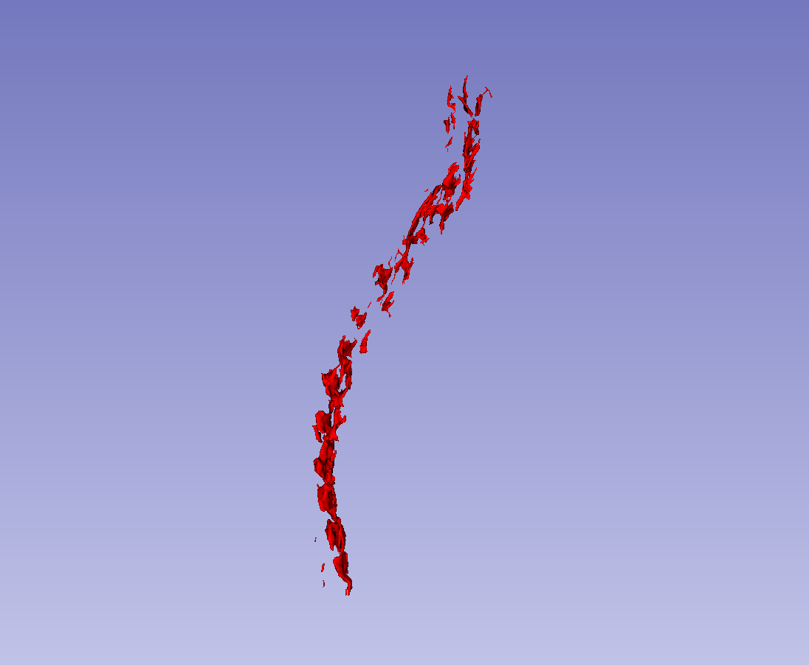
Landmark generation - Segmentation
The segmentation can be rendered as a surface

Slide 32
Landmark generation – Right-left
Defects are tested for and repaired side-wise
Points must be identified as belonging to right or left side of spine

Slide 33
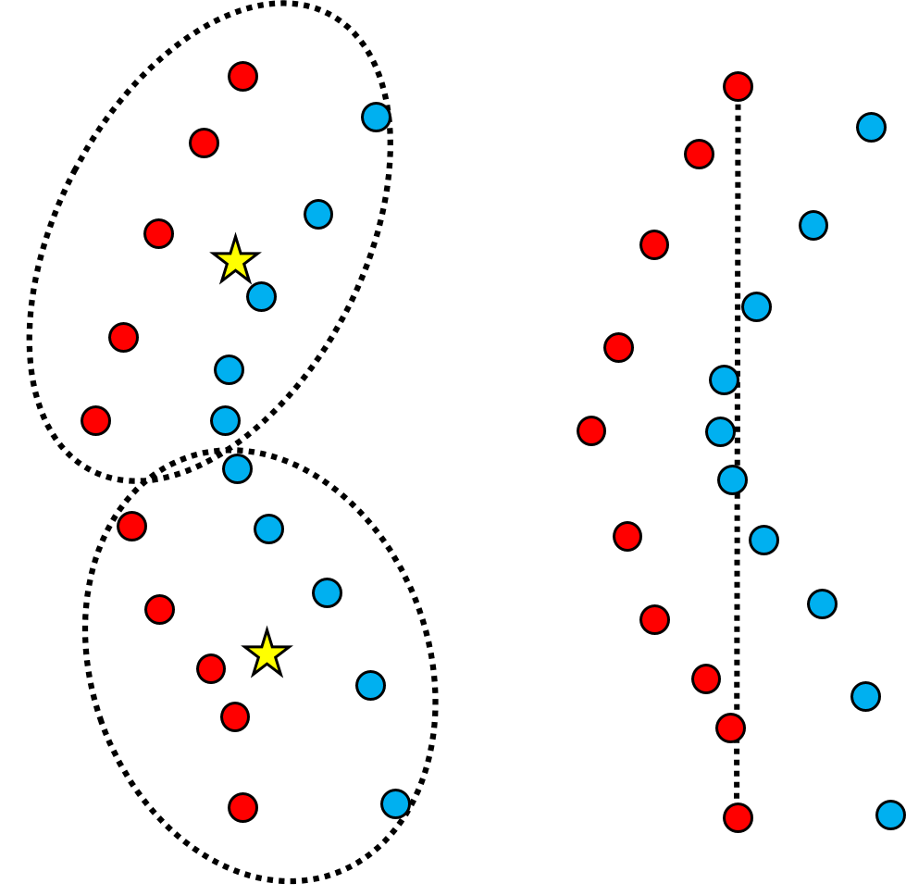
Landmark generation – Right-left
Un-normalized left-right landmark distribution not immediately separable
Curvature can prevent linear separation

Slide 34
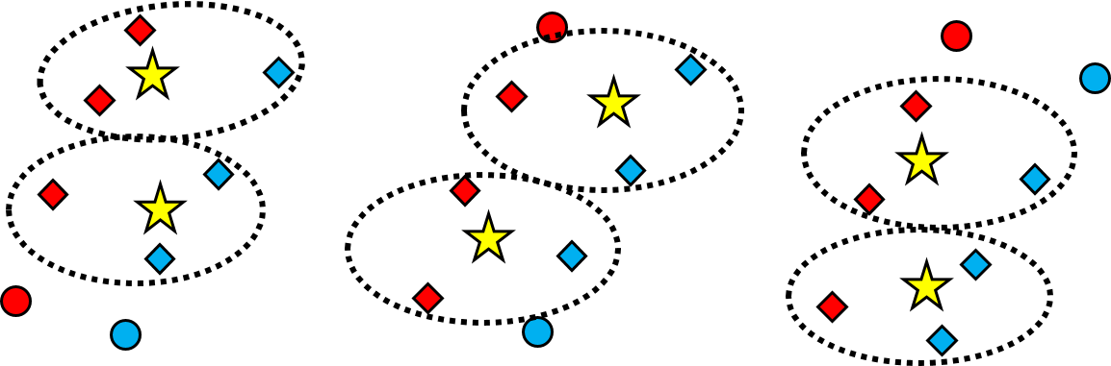
Landmark generation – Right-left
k-means classifies points landmarks window by window

Slide 35
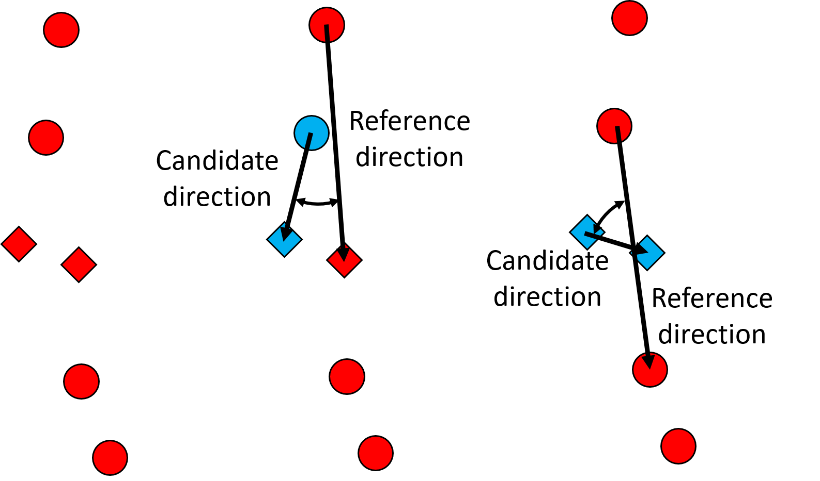
Landmark generation – Duplicates
Multiple points placed on a single landmark are identified by angles between inter-point vectors

Slide 36
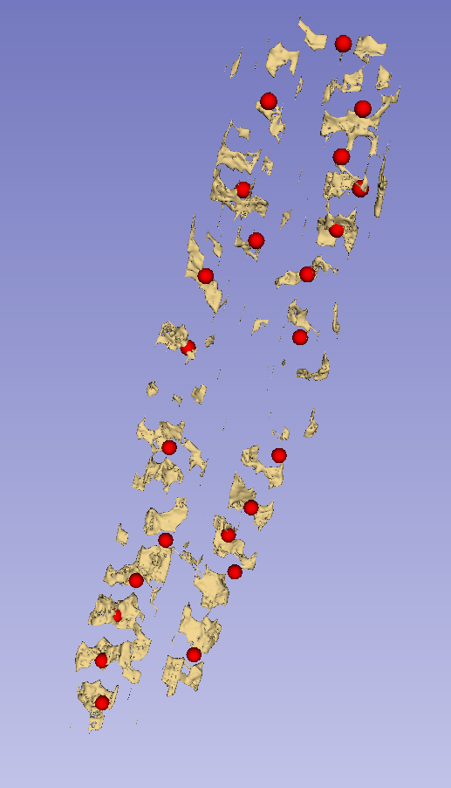
Landmark generation – Duplicates

Slide 37
Landmark generation – Omissions
Inter-landmark interval length are compared locally and globally
Unusually long interval lengths indicate omissions

Slide 38
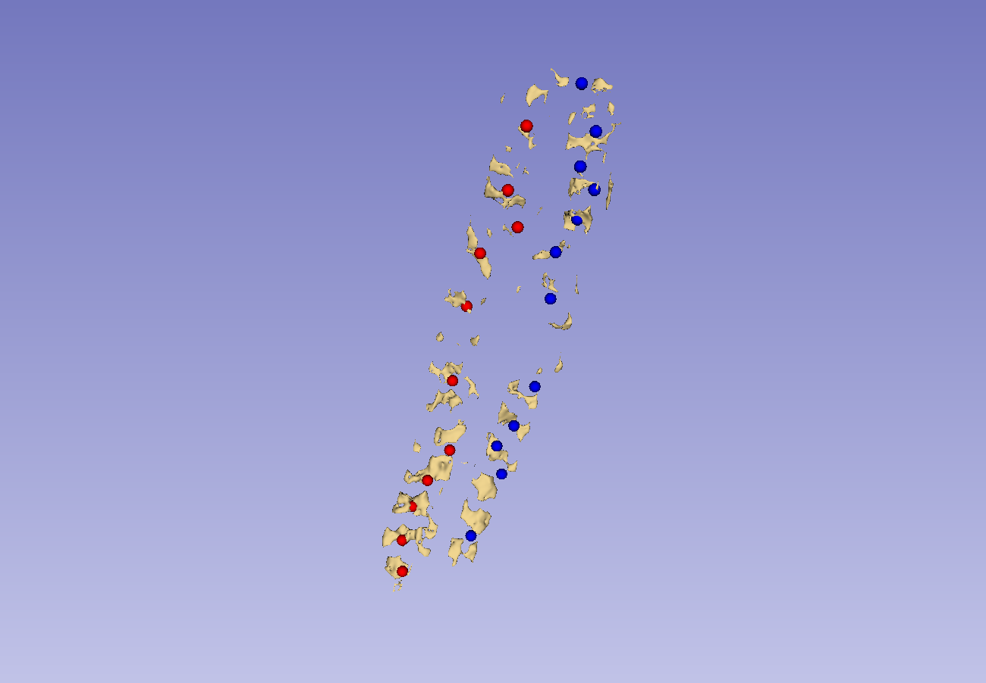
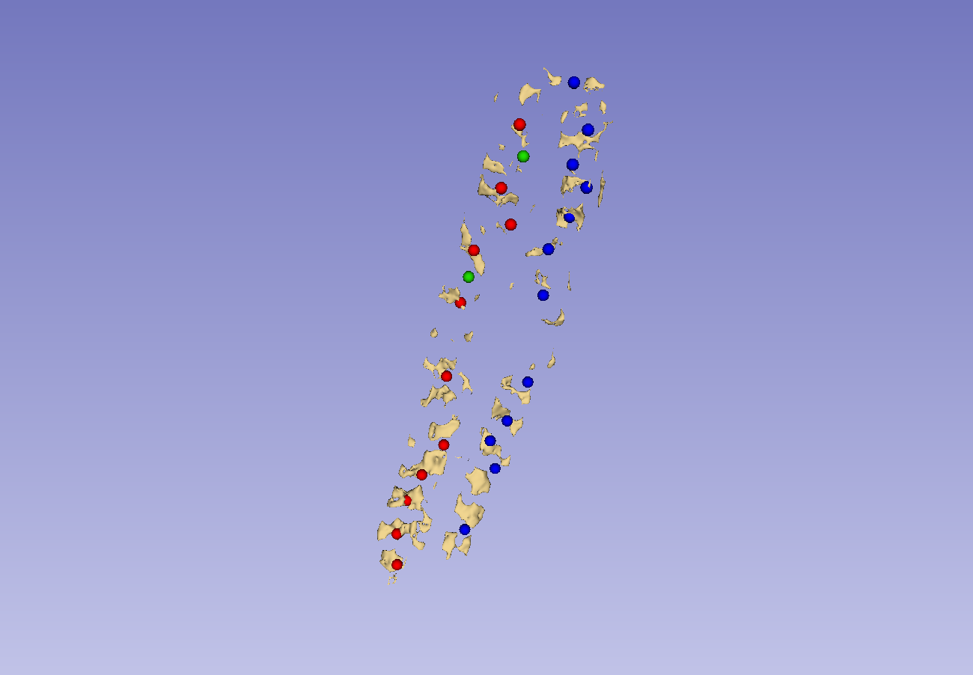
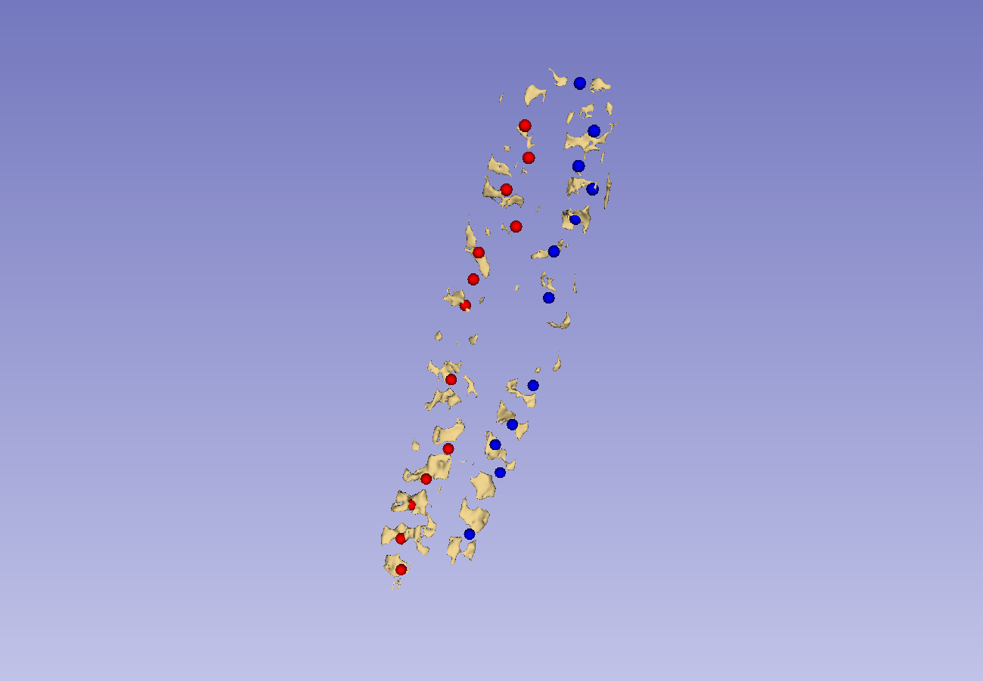
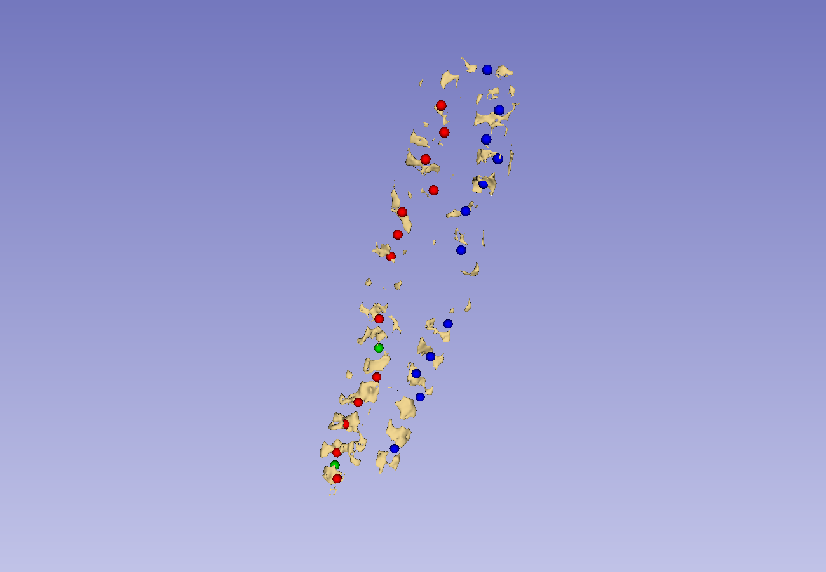
Landmark generation – Omissions

Slide 39

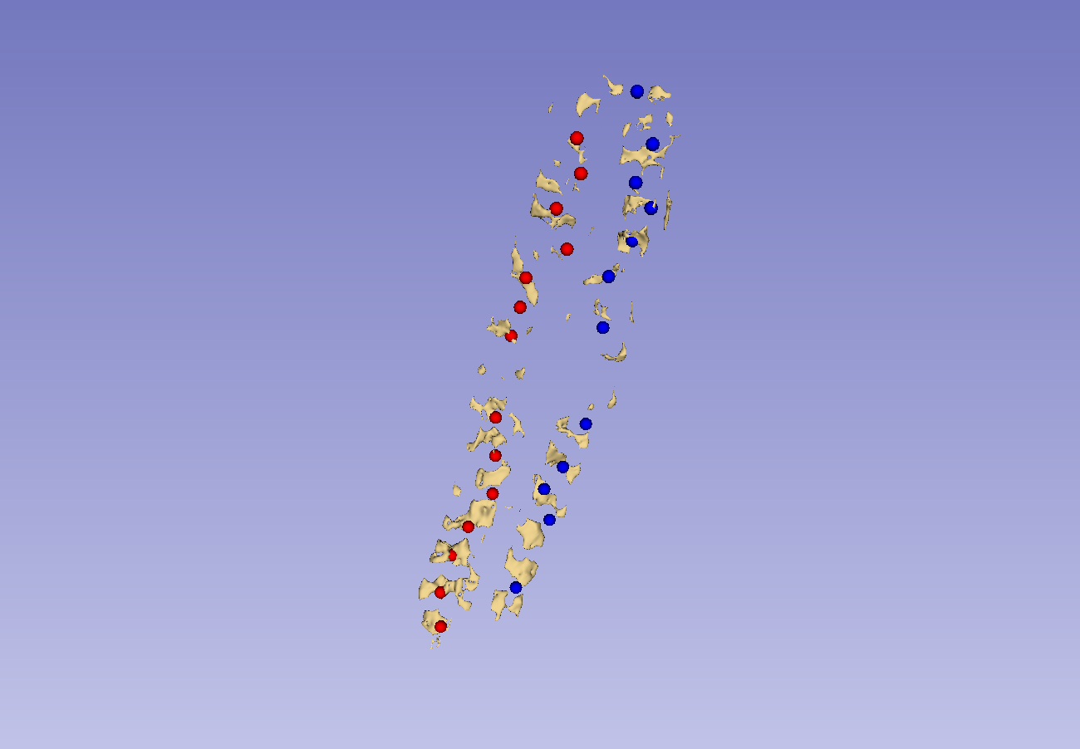
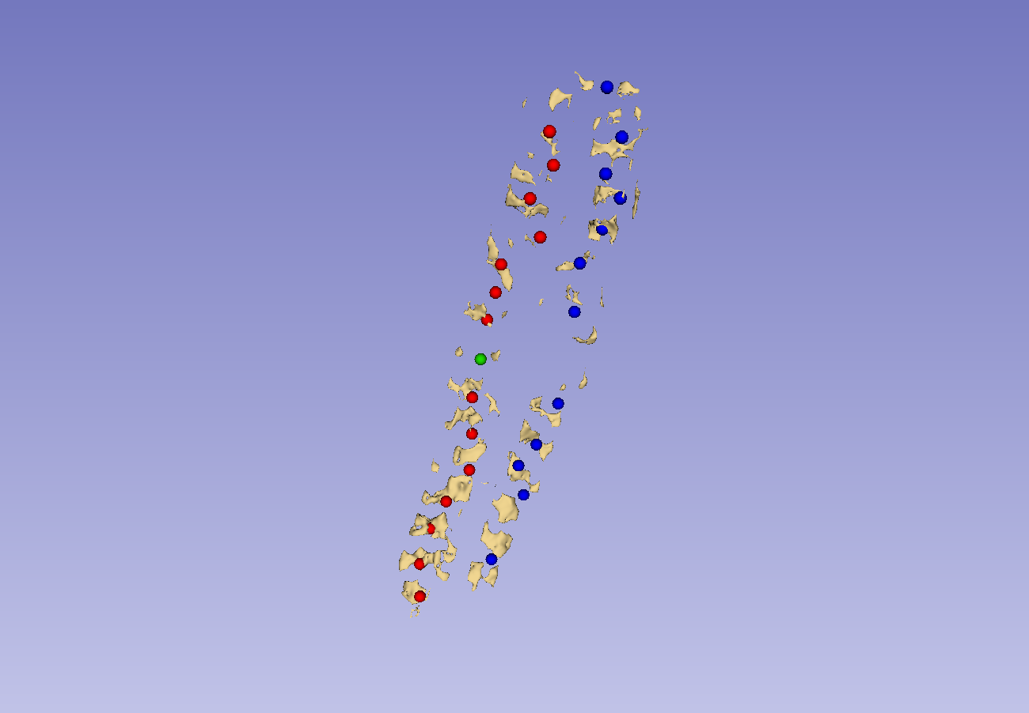

Landmark generation – Omissions

Slide 40
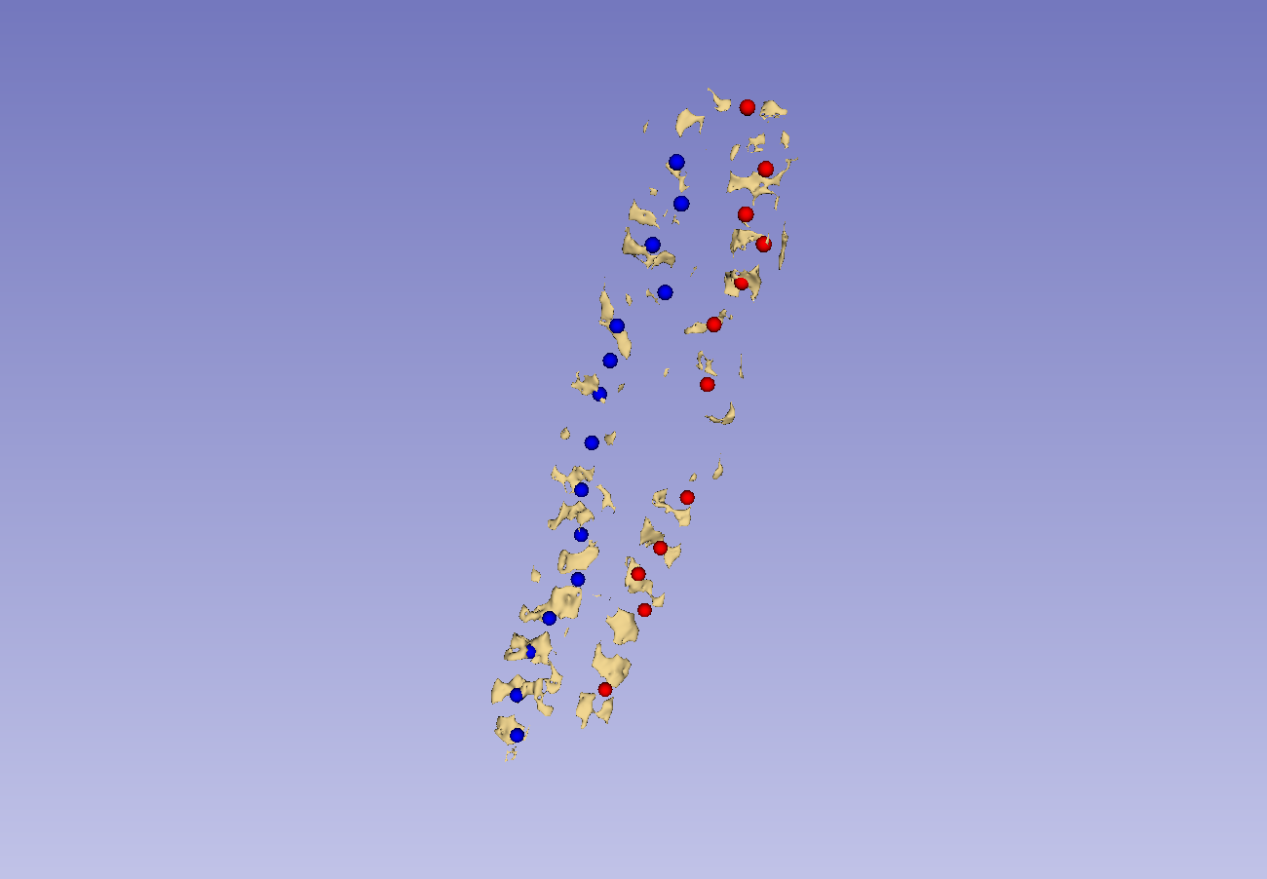
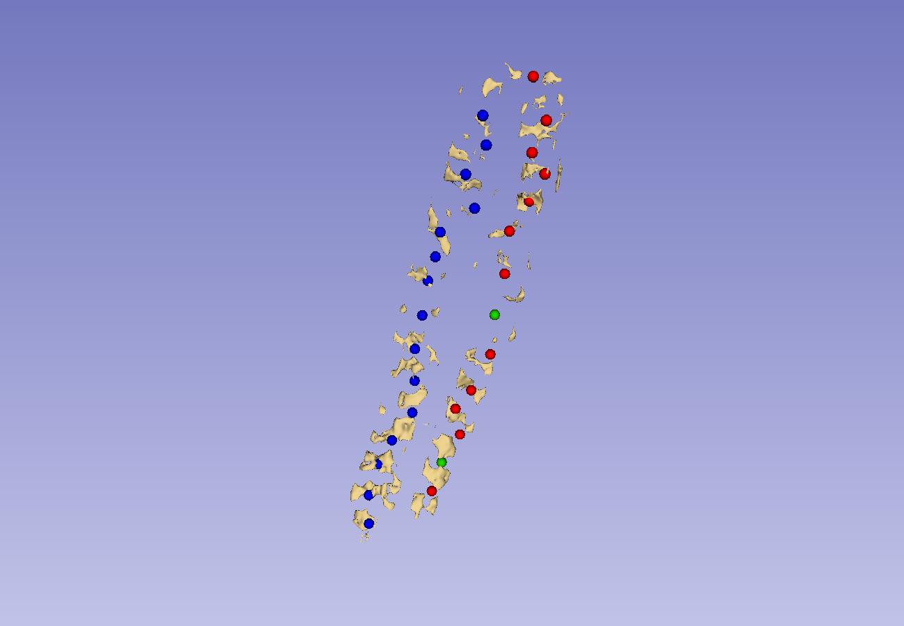
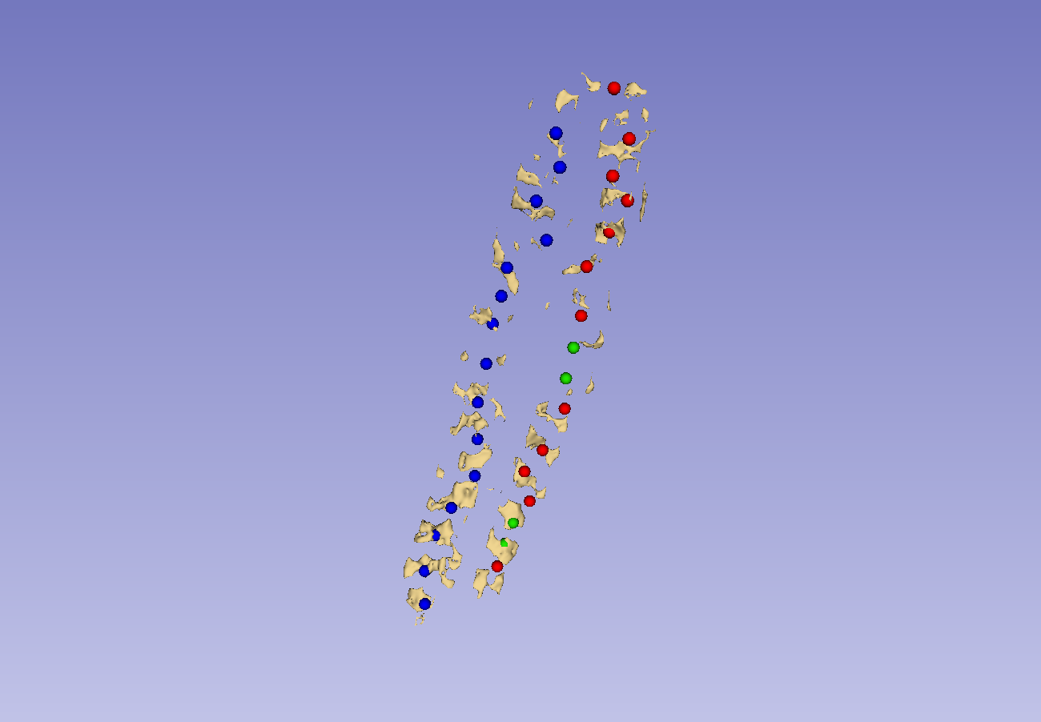
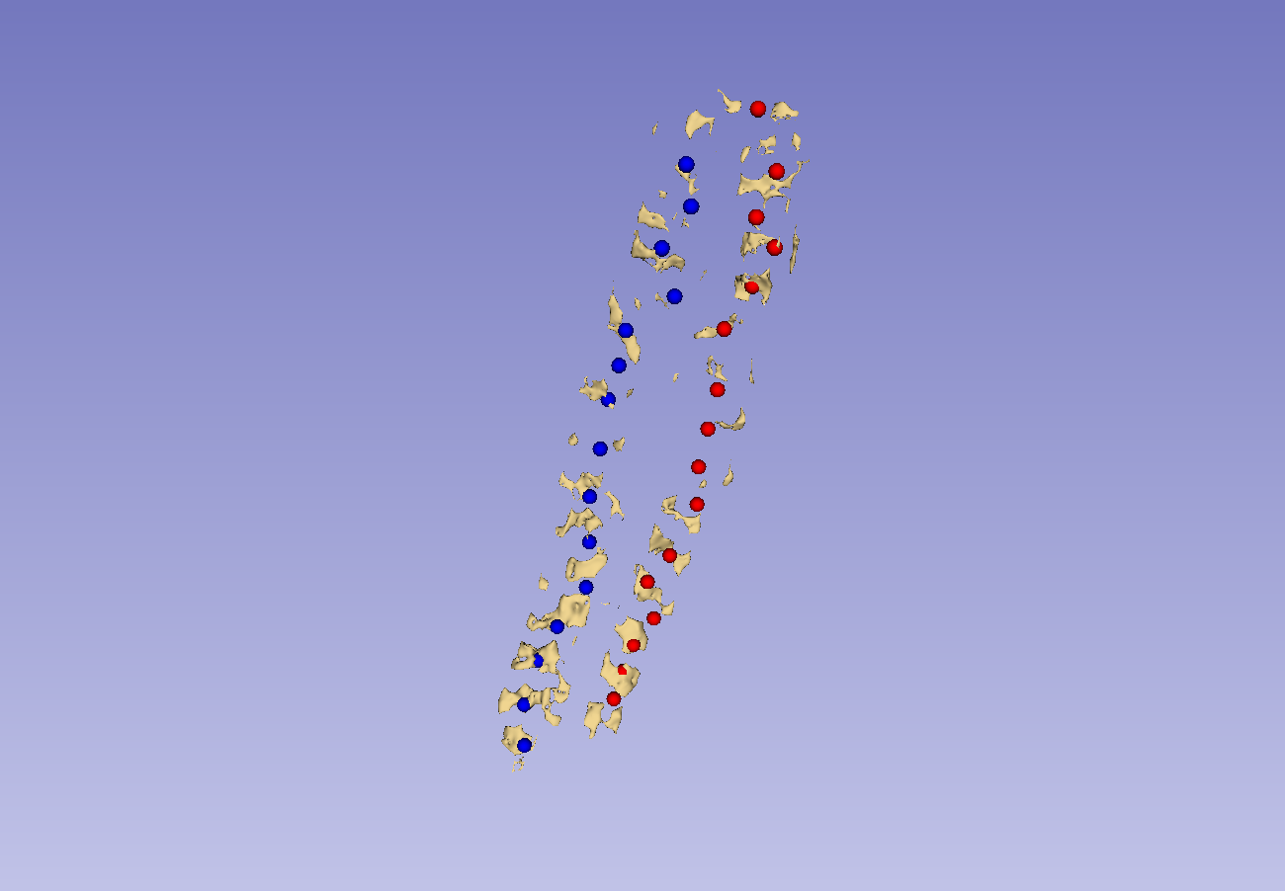
Landmark generation – Omissions

Slide 41
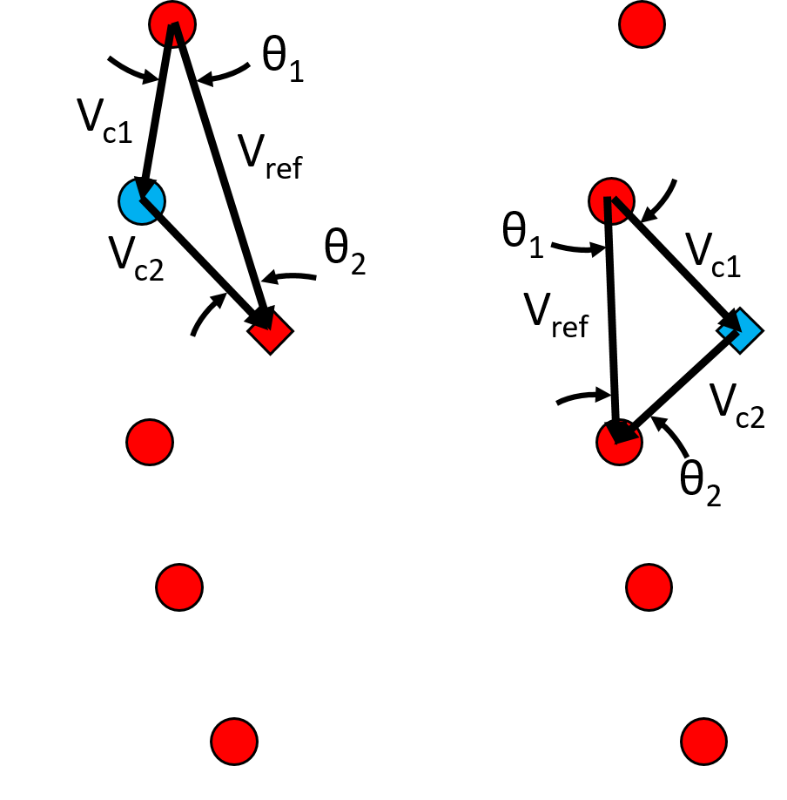
Landmark generation – Outliers
Outliers are identified similarly to duplicates, but as individual points

Slide 42



Landmark generation – Outliers

Slide 43



Landmark generation – Outliers

Slide 44


Landmark generation – Boundaries
Defects are corrected by interpolation
Overhanging points must be removed from both sides

Slide 45

Full workflow
5 volunteers were scanned
Scans were segmented
Landmarks were generated from segmentations
Visualizations were produced from landmarks

Slide 46





Full workflow

Slide 47





Full workflow

Slide 48





Full workflow

Slide 49





Full workflow

Slide 50





Full workflow

